Slide 1
Advanced Dvorak Technique
ADTV9.0 – Overview
Currently running ADT-Version 9.0 at CIMSS
  http://tropic.ssec.wisc.edu/real-time/adt
  Has been delivered to NOAA/STAR and we are currently working to implement into operations
Real-time validation at
  http://tropic.ssec.wisc.edu/real-time/adt/validation
ADT-V9.0 Journal Article
  Olander, T. L. and C. S. Velden, 2019: The Advanced Dvorak Technique for estimating tropical cyclone intensity: Update and new capabilities. Wea. Forecasting, 34, 905-922. doi: https://doi.org/10.1175/WAF-D-19-0007.1

Slide 2
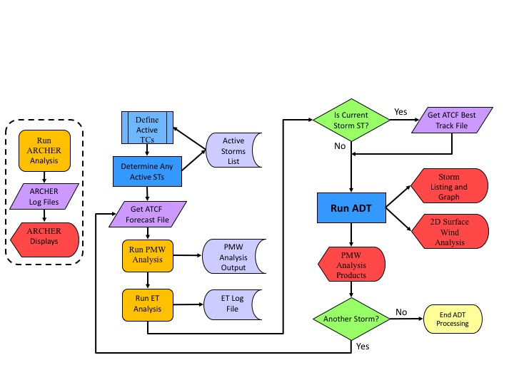
Advanced Dvorak Technique
ADTV9.0 Processing Overview

Slide 3
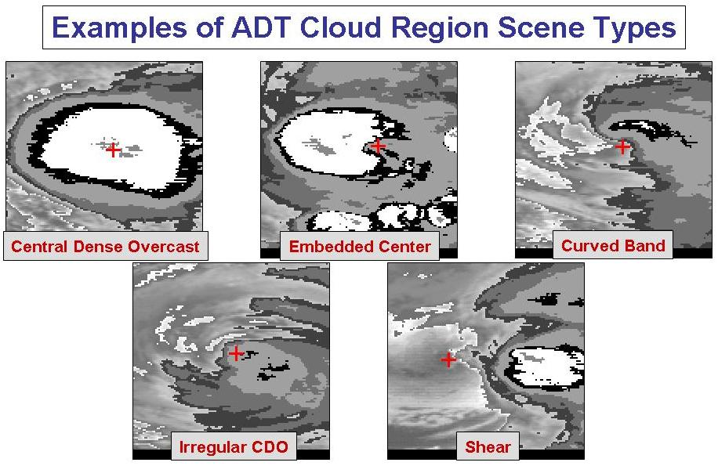
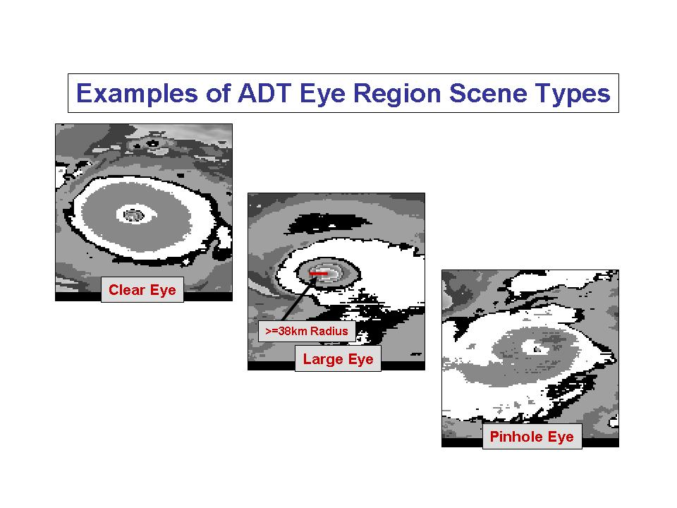
Advanced Dvorak Technique
ADTV9.0 Processing Overview

Slide 4
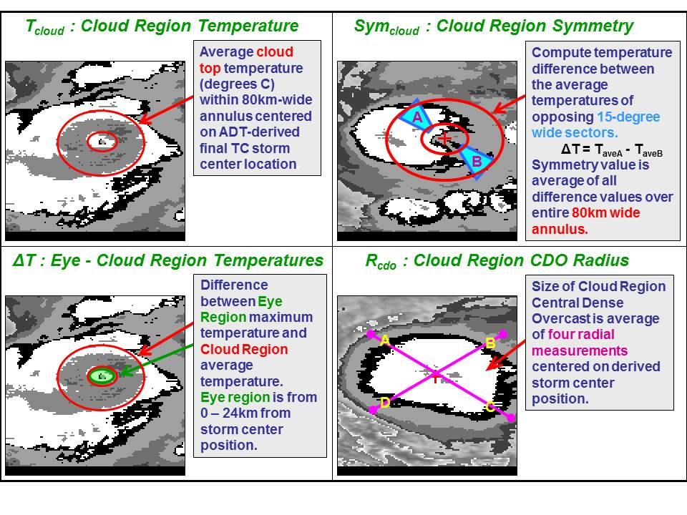
Advanced Dvorak Technique
ADTV9.0 Processing Overview
Eye Scenes
Atlantic : Intensity = 1.10 – 0.070*T_{cloud} + 0.011*ΔT – 0.015*Sym_{cloud}
West Pacific : Intensity = 2.65 – 0.030*T_{cloud} + 0.015*ΔT – 0.015*Sym_{cloud}
Cloud/CDO Scenes (excluding shear and curved band)
Atlantic : Intensity = 2.60 – 0.020*T_{cloud} + 0.002*R_{cdo} – 0.030*Sym_{cloud}
West Pacific : Intensity = 3.00 – 0.010*T_{cloud} + 0.001*R_{cdo} – 0.015*Sym_{cloud}

Slide 5
Advanced Dvorak Technique
ADTV9.0 – Overview
Primary ADT-V9.0 upgrades
  Extratropical Transition intensity estimate adjustment
  Analysis of Sub-Tropical systems with modifications
  ARCHER (V2.8) objective algorithm for auto center fix
  SFC wind radii estimates (4 quadrants, based on Knaff et al)
  Extreme TC (CI=>7.0) intensity adjustments implemented
  Modifications to allow for more frequent image sampling
  Handling of MW information (no longer a ‘HOLD’ status)

Slide 6
Advanced Dvorak Technique
V9.0 Modifications – Extratropical Transition
Extratropical Transition adjustment
  Research collaboration with Clark Evans at Univ. of Wisconsin – Milwaukee
  Primary finding: ADT too weak in ET phase
  Regression-based adjustments (Atlantic/non-Atlantic) are applied to the ADT CI# based on real and simulated ET cases
  ET cases with decent Vmax verification used
  ET is identified (and triggered in the ADT) by FSU phase space “beta” parameter
    Current and previous (6hr) beta values must be >10, and latitude > 20N/S
  50% of previous 12-h period ADT scene types must be ‘shear’ or ‘curved band’
  Once ET is triggered, the intensity adjustment is applied to the ADT CI# for the duration of the storm (and back-blended 12-h from start of ET implementation).

Slide 7
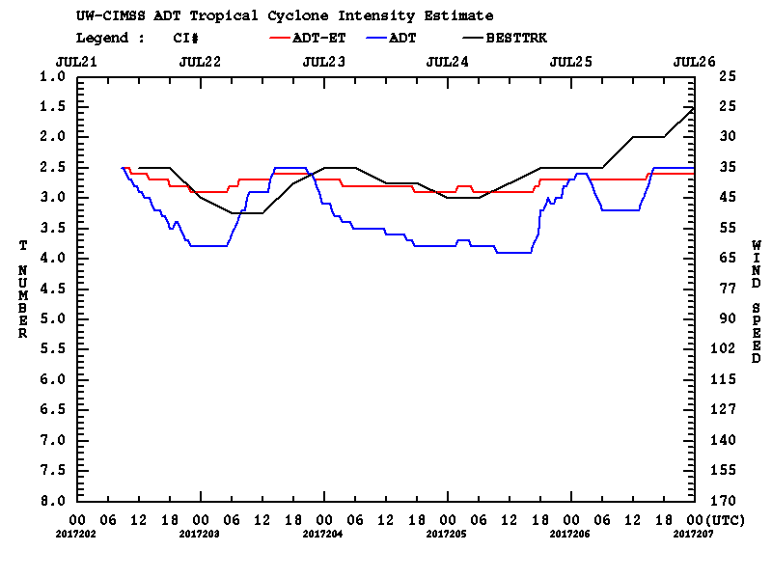
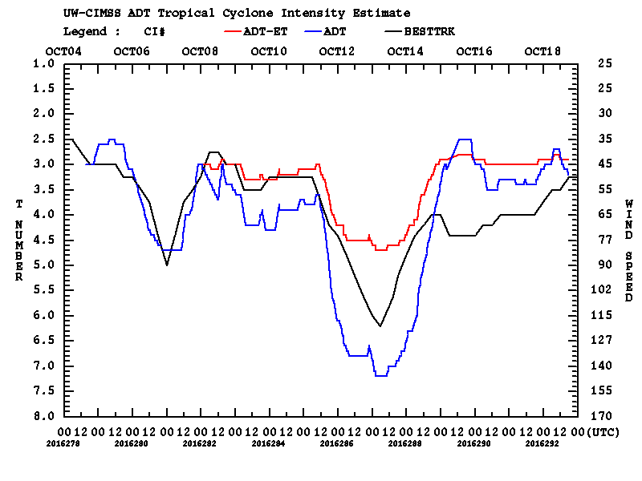
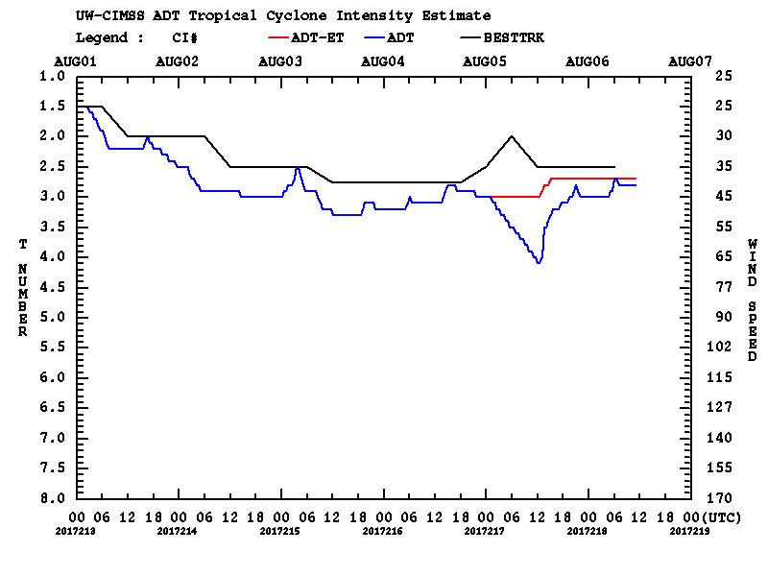
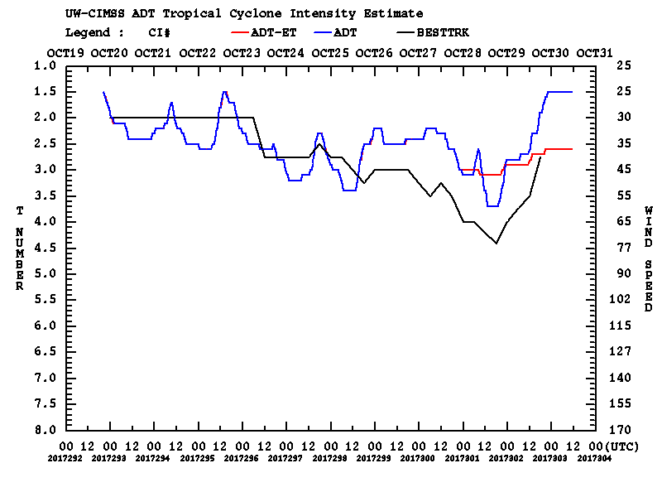
Advanced Dvorak Technique
V9.0 Modifications – ET Examples
--- ADT-V9.0 --- ADT-V8.2.1
09W 2017
15L 2017
13W 2017
27W 2017

Slide 8
Advanced Dvorak Technique
V9.0 Modifications – Subtropical Cyclones
Analysis of Sub-Tropical systems
  Finding: ADT always too weak is ST systems using regular TC methodology
  Added new ADT keyword to identify when a storm is classified as Subtropical, as designated with ”SD” or “SS” indicator in JTWC or NHC ATCF Best Track file
  ADT ST intensity estimates based on modified Curved Band (CB) analysis
    Examines additional (warmer) cloud top temperature range between -10C and -30C
    Result: T#s increased to partially account for the ADT weak bias
    Additional +5 knot adjustment applied (based on remaining statistical bias)
  Does not allow ‘Shear’ scene type, only ‘CB’ and ‘Irregular CDO’

Slide 9
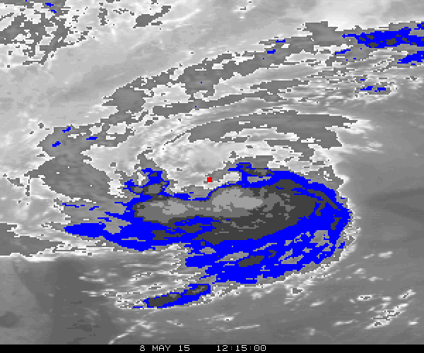
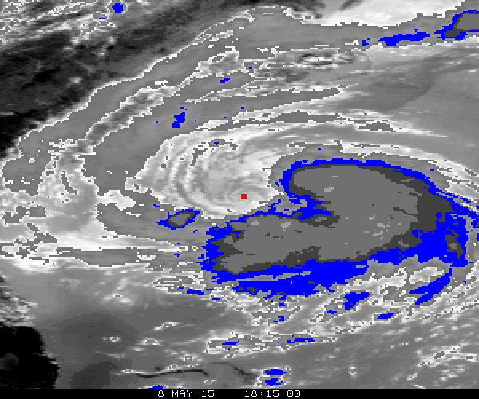
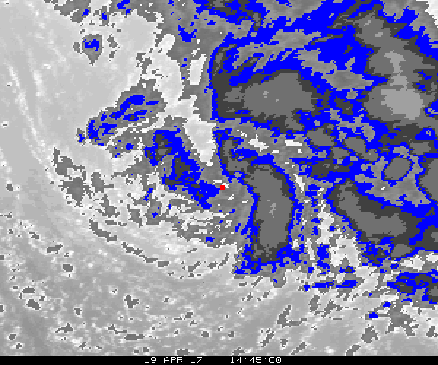
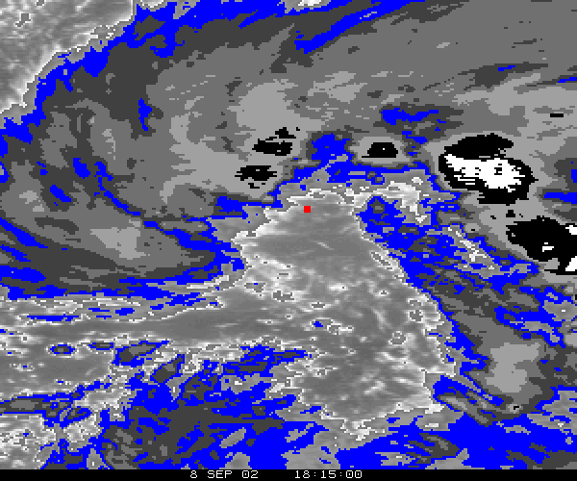
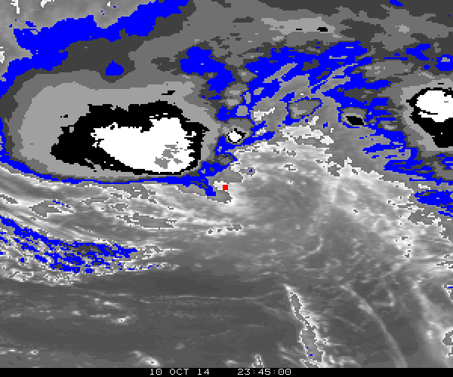
Advanced Dvorak Technique
V9.0 Modifications – Subtropical Cyclones
Blue shaded area represents new ST BD curve range
-10C to -30C
Increases spatial size and coherency of curved band scene being examined

Slide 10
Advanced Dvorak Technique
V9.0 Modifications – Subtropical Cyclones
Statistical Analysis (Development sample)
  Atlantic Basin cases between 2000 and 2015
  ADT CI# intensity estimates vs Best Track w/in 30 minutes (with aircraft recon observation w/in 3 hours of NHC Best Track)
  66 homogeneous cases
  Dvorak: operational Dvorak estimates from TAFB/SAB (averaged when coincident)
  ADT T/CI# converted to Vmax using Dvorak relationship
Corrective measures ameliorate most of the ADT ST weak bias
Vmax (kts) Bias |Mean| StDv
ADTV8.2.1 -12.1 12.1 6.5
ADTV9.0 -1.4 5.4 6.4
Dvorak -1.5 4.7 6.1

Slide 11
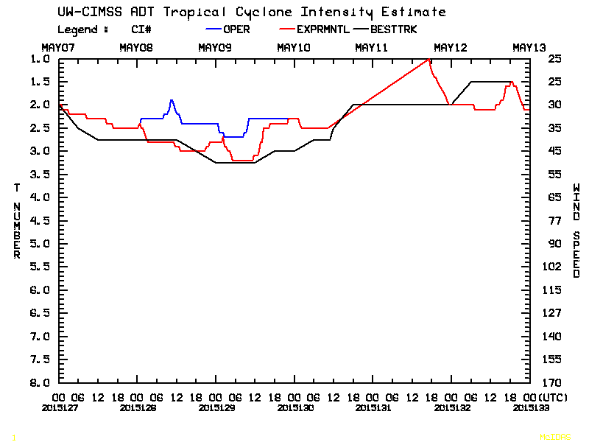
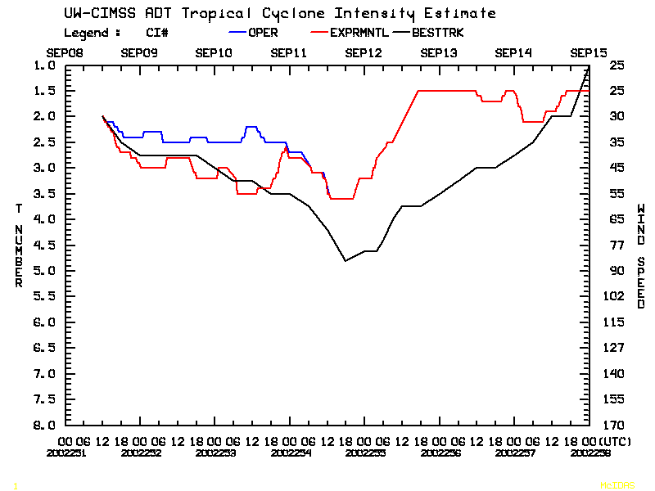
Advanced Dvorak Technique
V9.0 Modifications – Subtropical Cyclones
Subtropical
2015 Tropical Storm Ana - 01L
Subtropical
Extratropical
(no ET adjustment
applied)
2002 Hurricane Gustav – 08L

Slide 12
Advanced Dvorak Technique
V9.0 Modifications – ARCHER V2.8
Implementation of ARCHER (V2.8) objective TC center fix algorithm
  ARCHER V2.8 significantly upgraded from original algorithm used in ADT
    Code rewritten in C to match current ADT code
    Allows ADT ARCHER code to be ported more easily to remote sites (e.g. SAB)
  Obj. TC center posits derived hourly using multi-spectral/multi-platform imagery
    Geostationary: IR, SWIR, and Visible imagery from GOES, Meteosat, Himawari
    PMW: 37GHz and 85-92GHz imagery from SSMIS, GMI, AMSR2
    Scatterometer data available but not currently employed (future investigations)
  Position extrapolated to current ADT analysis time from ARCHER history file
  Confidence indicators for each available fix determines the best position estimate and whether it will be used by the concurrent ADT analysis
    Currently testing two confidence threshold values

Slide 13
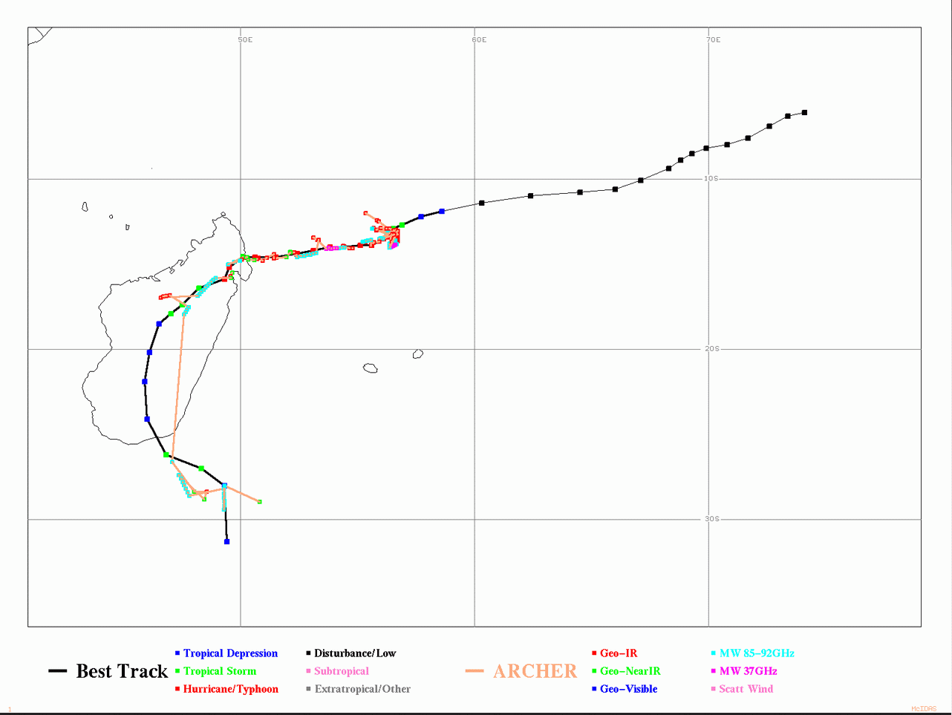
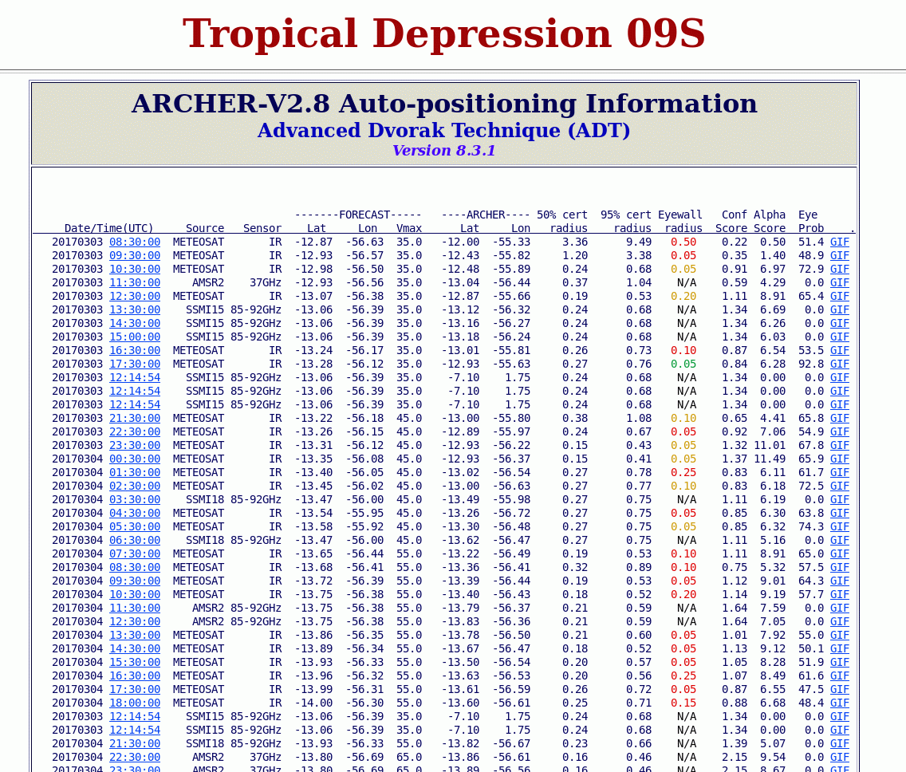
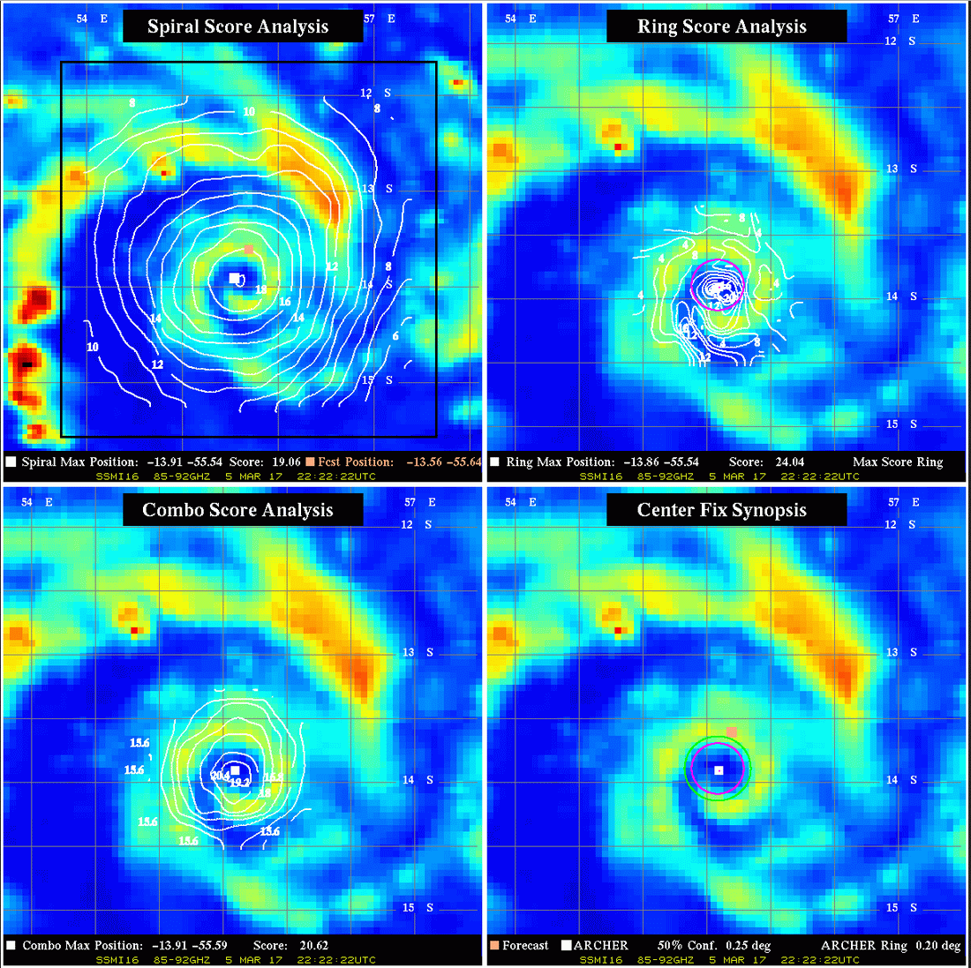
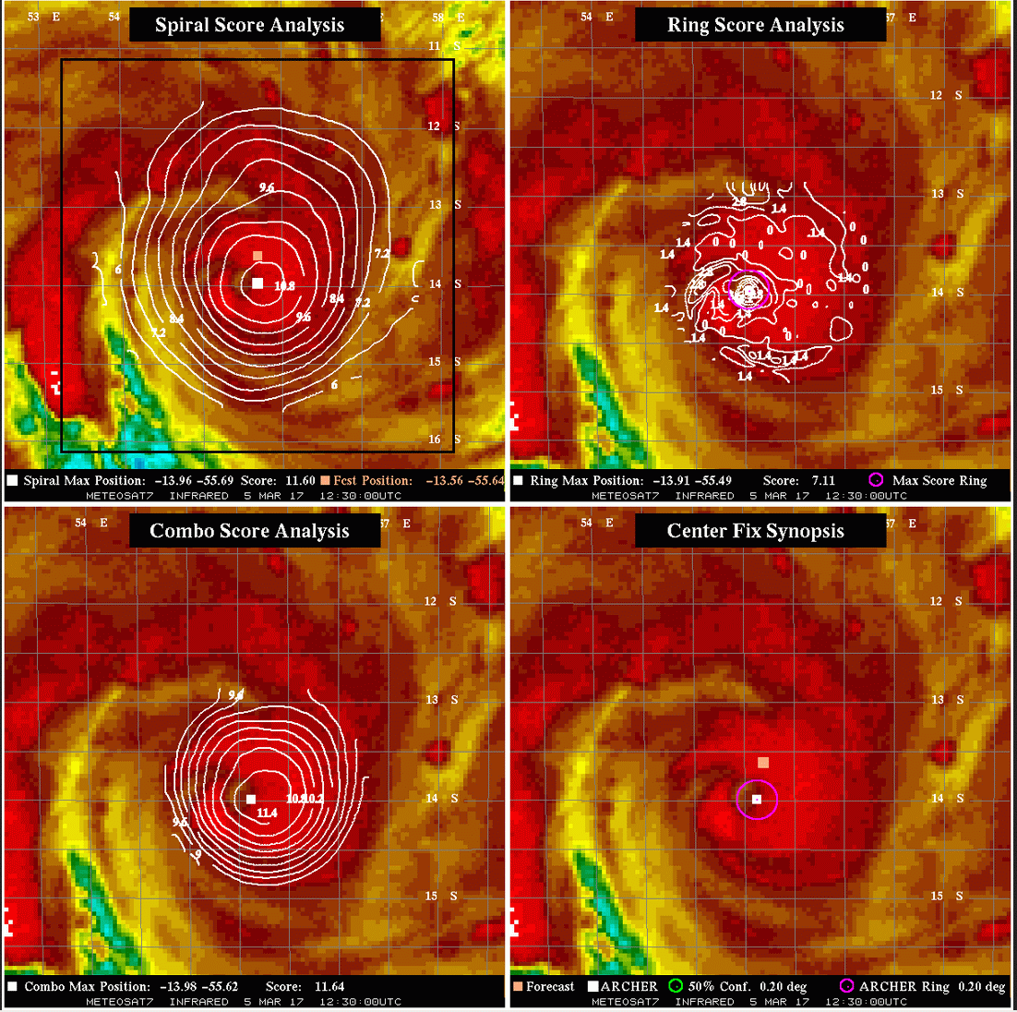
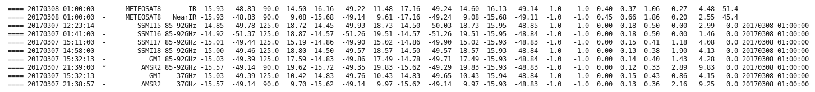
Advanced Dvorak Technique
V9.0 Modifications – ARCHER V2.8
ARCHER analysis webpage products

Slide 14
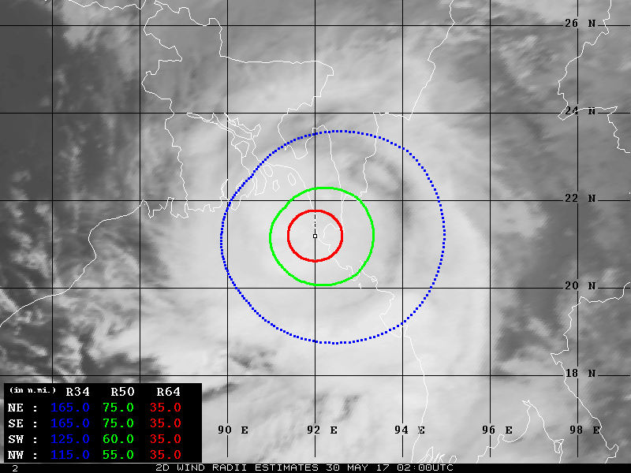
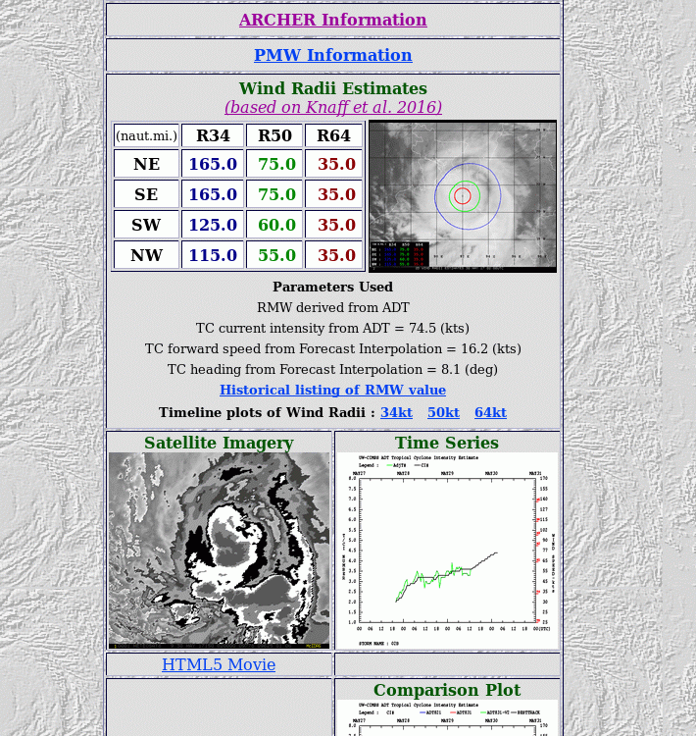
Advanced Dvorak Technique
V9.0 Modifications – SFC Wind Radii estimates
SFC wind radii estimates
  Based upon Knaff et al. 2016
  Uses current ADT CI# and RMW estimates (or climatological value if not available), and storm latitude/speed to determine 34/50/64 kt wind radii in four storm-relative quadrants
  Current analysis and graphical displays of wind radii values available, along with a past history listing

Slide 15
Advanced Dvorak Technique
V9.0 – Other Modifications
Extreme TC (CI=> 7.0) intensity adjustments implemented
  Based upon analysis of “historical extreme TC events” study (Velden et al., 2016)
  Adjustments of 0.1 (Atlantic/East Pacific) to 0.3 (West Pacific) T# applied to initial eye scene type regression equations to T# => 7.0
  Modifications led to implementation of three regression equations for eye scenes
    Atlantic/East Pacific, West Pacific, Other
Modifications to allow for more frequent image sampling
  Motivation: Imagery now available for analysis at 5/10 min. intervals from GOES-16/Himawari-8
  Impact study conducted to investigate impact of higher temporal data on ADT
    Minimal impact in vast majority of cases using higher temporal data
    Occasional improvement in eye scene detection, but also more short-term “noise”
    CIMSS will continue to use 30-minute imagery

Slide 16
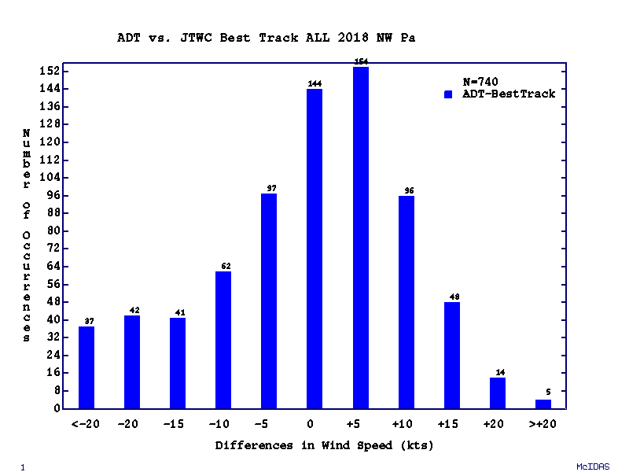
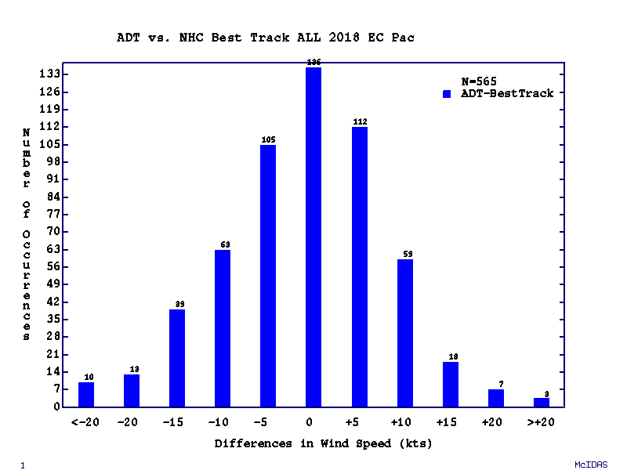
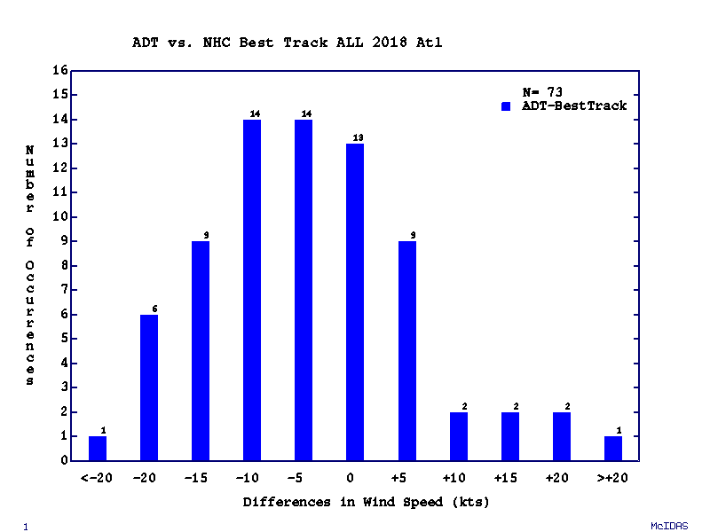
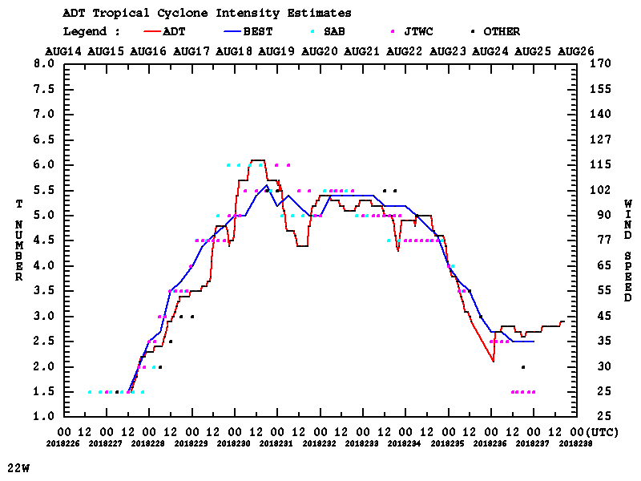
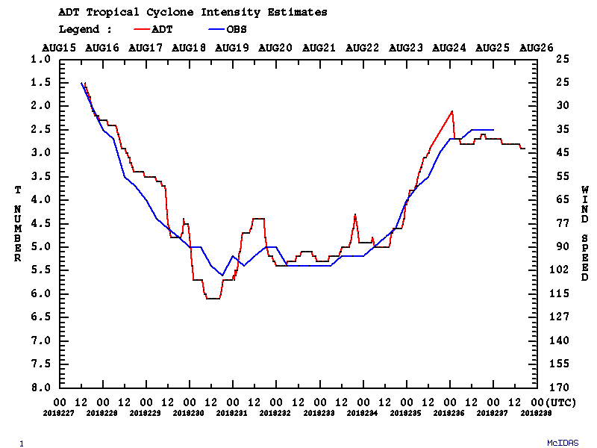
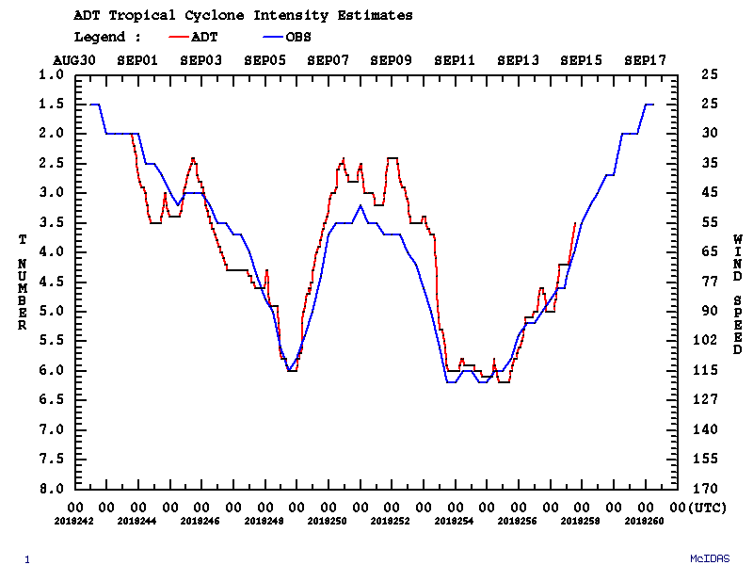
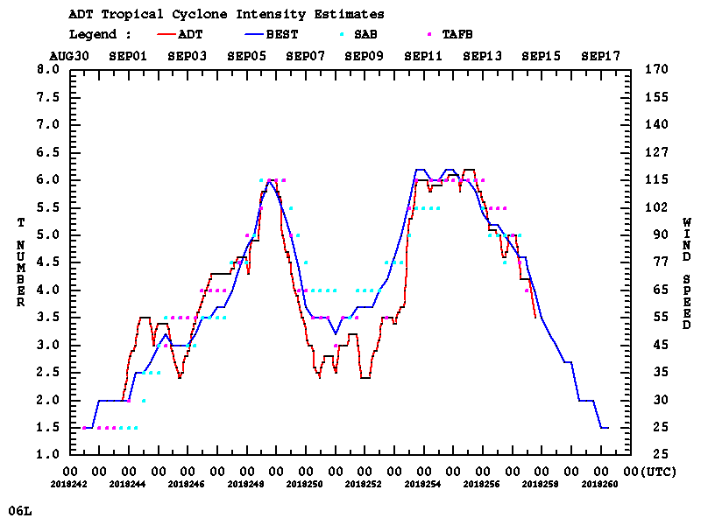
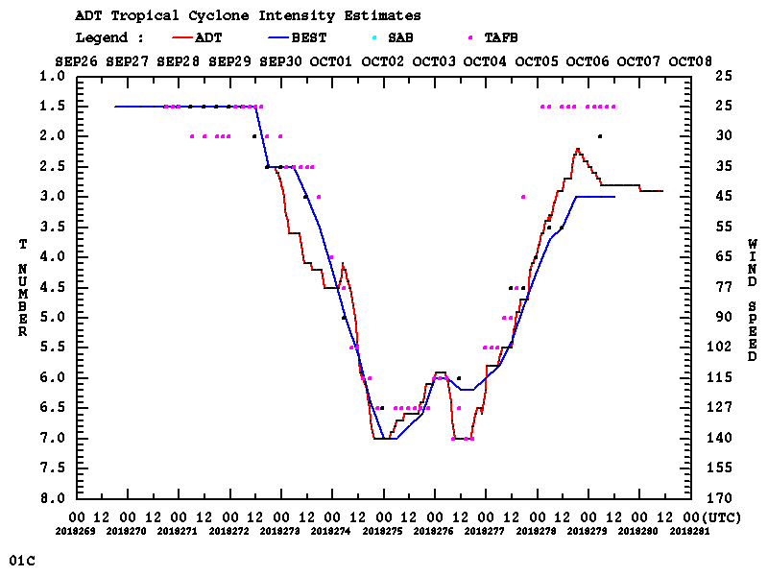
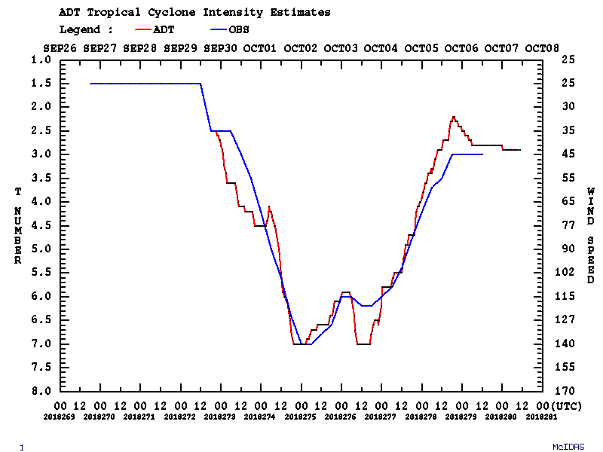
Advanced Dvorak Technique
V9.0 – 2018 Verification Statistics
W Pacific – 740 total matches
bias aae stdv
CI# 0.05 0.47 0.58
Wind(kts) -0.71 8.65 11.16
MSLP(mb) 2.28 5.90 7.98
N Atlantic – 73 total matches
bias aae stdv
CI# -0.22 0.43 0.49
Wind(kts) -4.30 8.85 10.27
MSLP(mb) 0.02 6.67 9.71
E/C Pacific – 565 total matches
bias aae stdv
CI# -0.01 0.35 0.45
Wind(kts) -0.62 7.08 9.17
MSLP(mb) -1.84 5.10 6.48
Soulik - 22W
Florence - 06L
Walaka - 01C

Slide 17
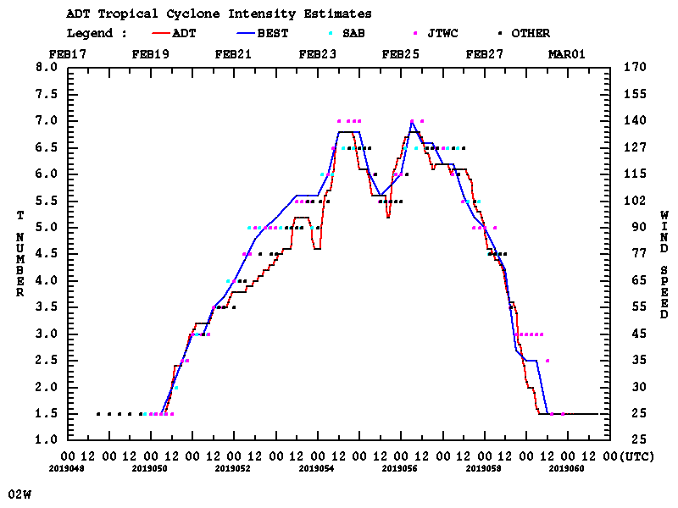
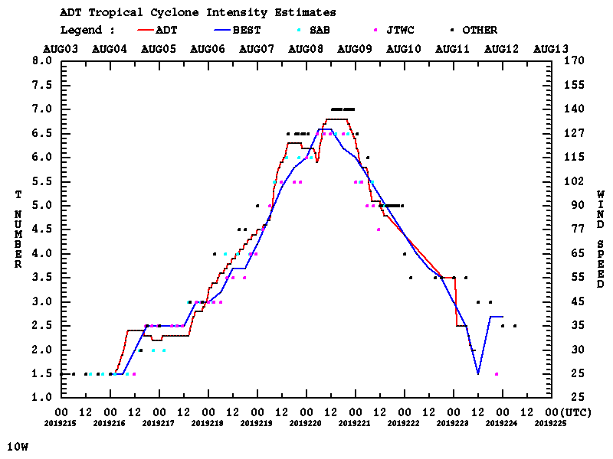
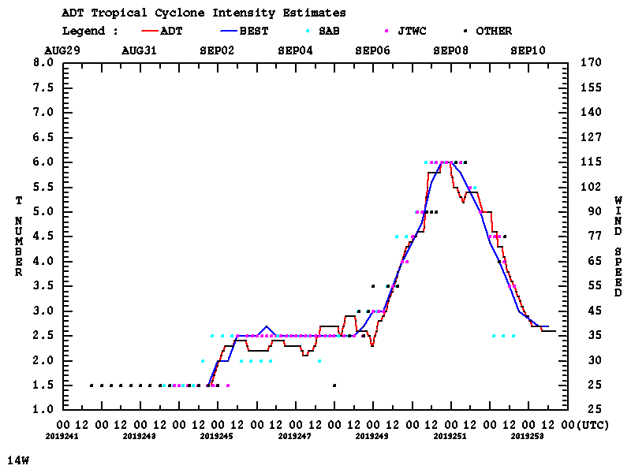
Advanced Dvorak Technique
2019 Cases

Slide 18
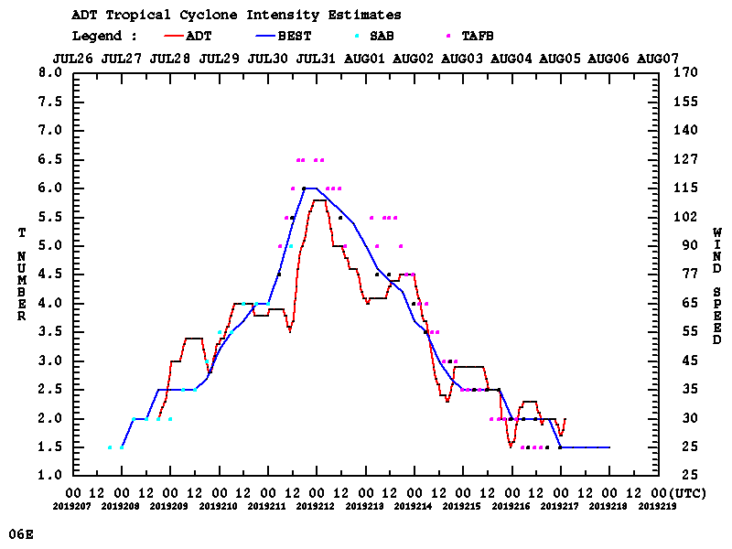
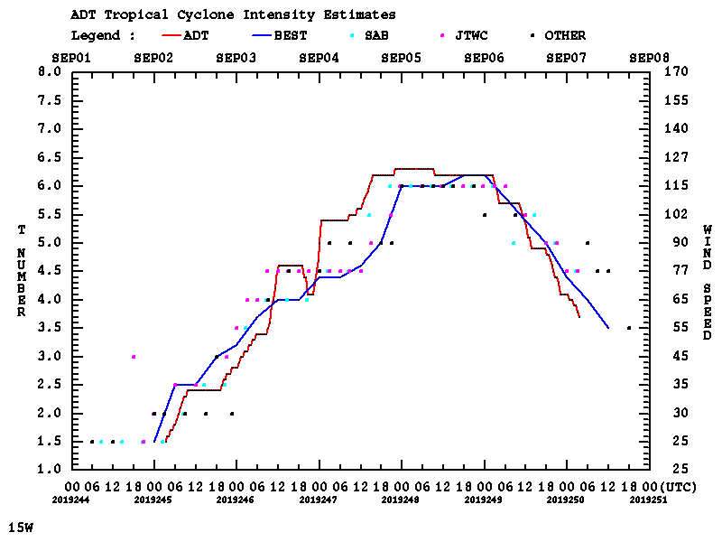
Advanced Dvorak Technique
2019 Cases
Note spread in OpCen estimates

Slide 19
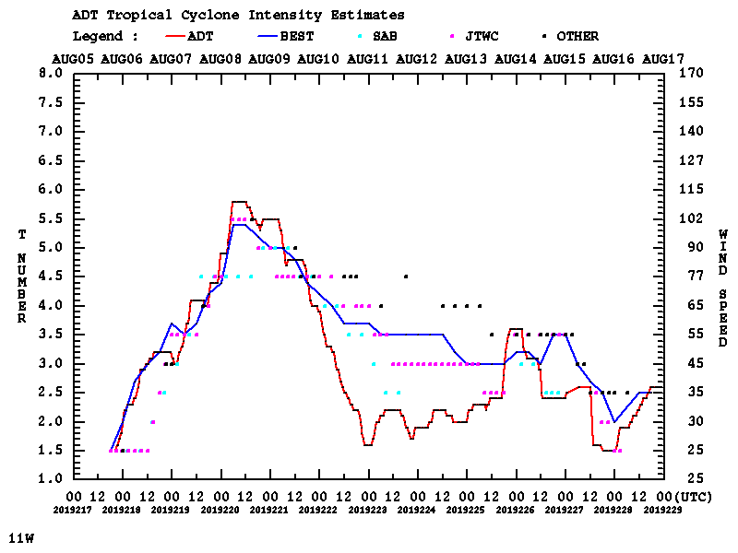
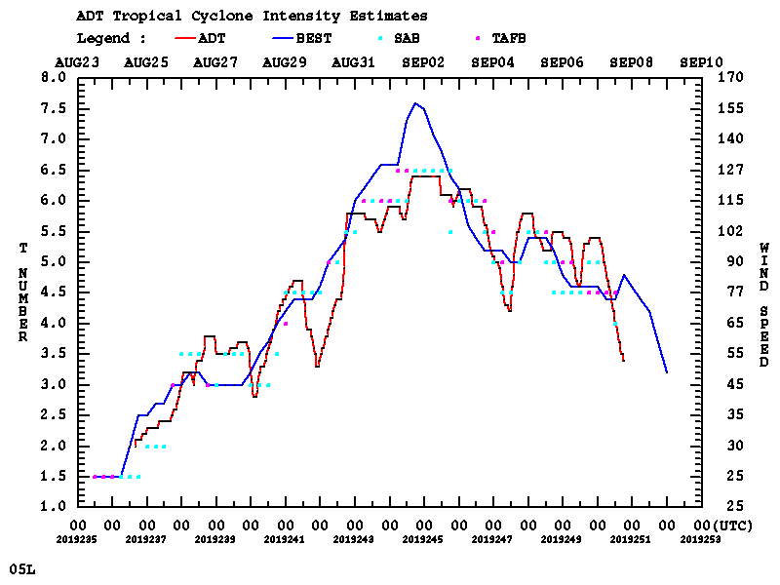
Advanced Dvorak Technique
2019 Cases
Note spread in OpCen
Note similarity to OpCen

Slide 20
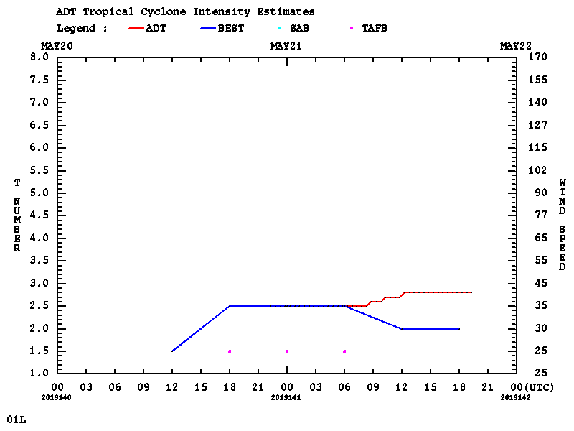
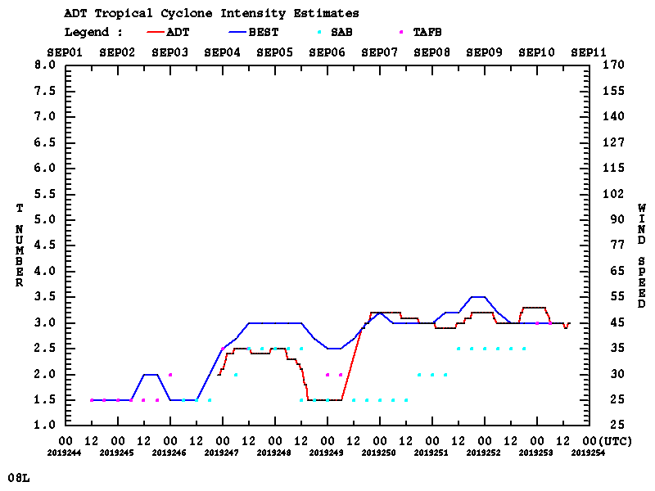
Advanced Dvorak Technique
2019 Cases
Subtropical
- ADT started May 30/22:30Z
Aircraft Validation!
ADT ET Initiation
at Sept 07/1250Z

Slide 21
JTWC Decision Aids
JTWC currently employs two worksheets to aid in the decision on the current status of a current TC or a forming/invest TC
  The “Low-Medium-High” worksheet is used to determine the likelihood of an invest system to develop into a tropical cyclone in the future
  The “Cyclone Phase” worksheet is used to determine the state of a current tropical cyclone; whether it is tropical, subtropical, or extratropical
  Both worksheets are subjective and take a significant amount of time to complete. Developing a system to access and analyze each aspect of the two worksheets would save the JTWC forecasters significant amounts of time.
    This system would NOT replace the analyst, but instead provide an objective first guess and also provide quick access to each parameter in one location instead of many different locations on the internet
    The system would allow for user override to let the analyst modify individual results as they deem it necessary.

Slide 22
JTWC Decision Aids
Currently all of the analysis for both worksheets are running and creating valid analysis for every storm and invest >=15 knots
  Added weaker invests to analysis since invests on TC homepage are filtered by current strength (>=20kts)
  Webpages for all storms are created automatically
    All text analysis and associated graphics (when available) are displayed
    Historical storm analysis tables are stored in an online database, which can be listed and modified (via dropdown menus) by the forecaster
    Modified records are stored in storm database along with automated records
  Analysis products are still being evaluated…
    I have some 2018 and 2019 JTWC worksheets to compare with the automated results, but I need more!
  http://tropic.ssec.wisc.edu/real-time/jtwc_aids (password protected)

